Slide 1
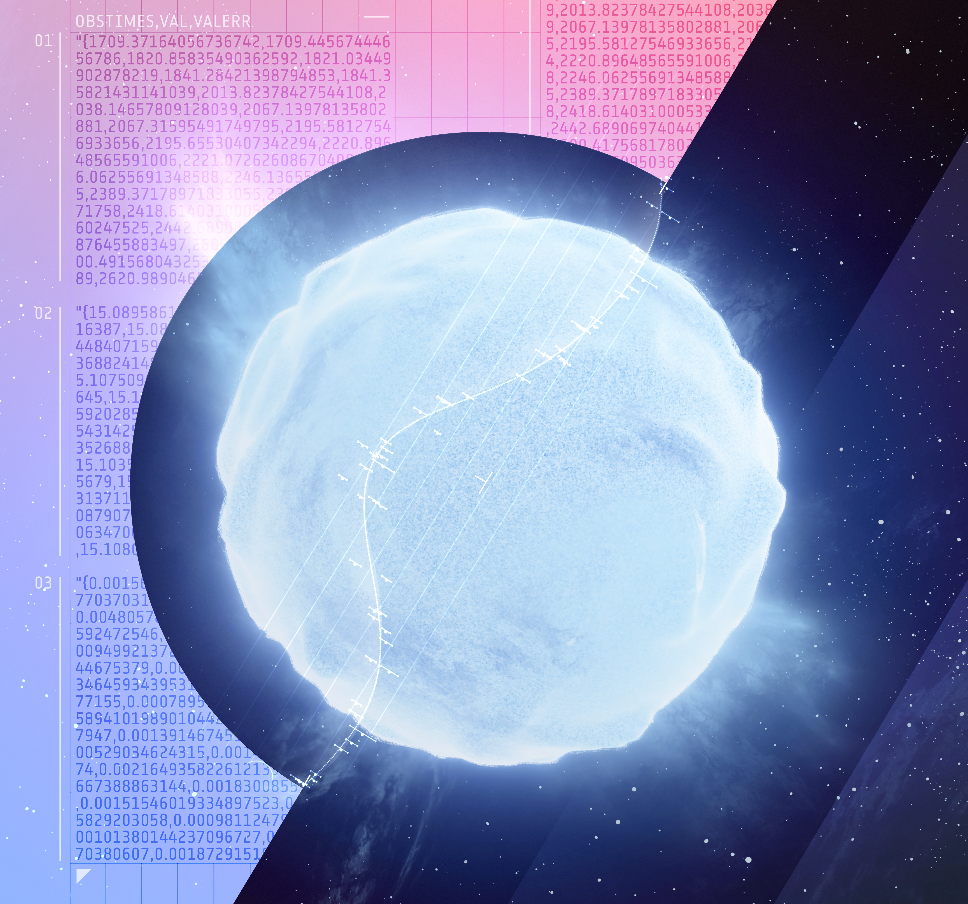
Periodicities of binary Cepheids - Exploring a novel approach based on distance correlation K. Barbey^{1*}, G. Viviani¹, R.I. Anderson¹
¹ Institute of Physics, EPFL, Chemin Peg 51b, CH-1290 Versoix
* kent.barbey@epfl.ch
Photo Credits: GAIA Vari Citizen Science Project

Slide 2
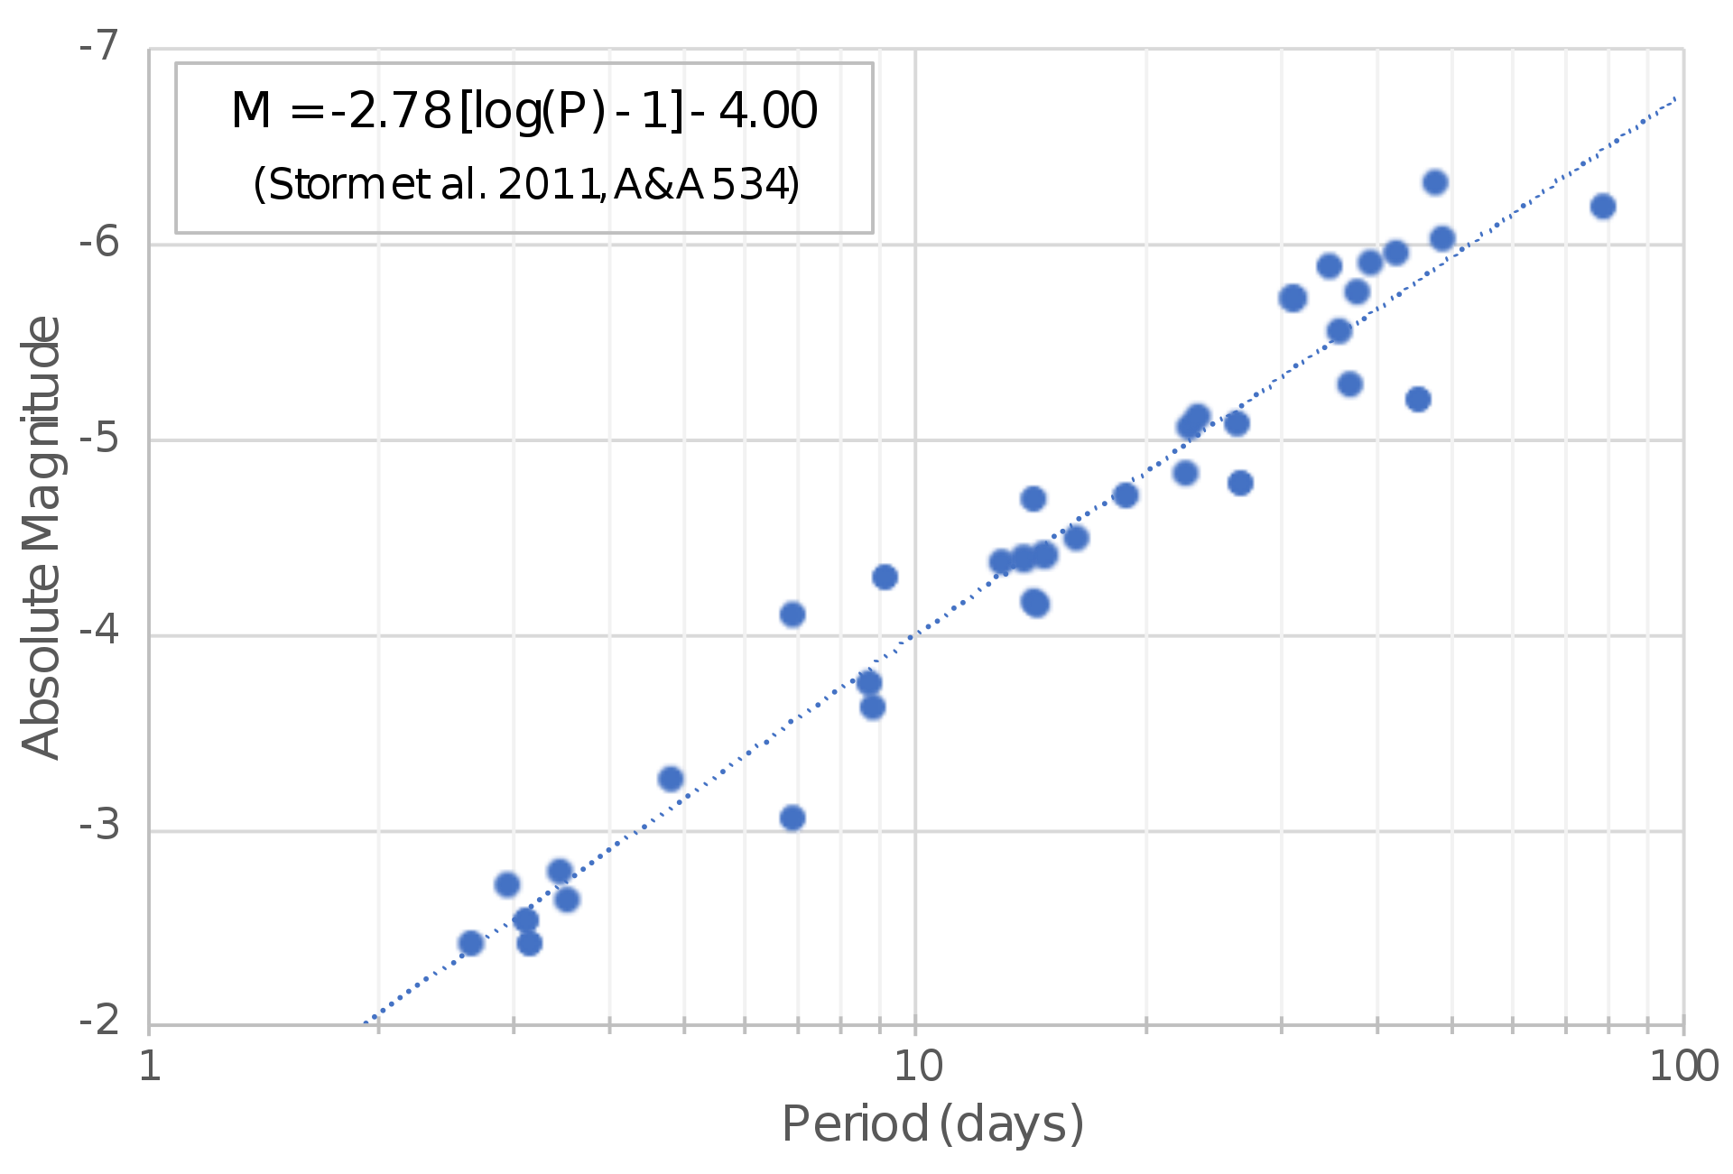
Context I Period, Luminosity and the Hubble Constant
H₀: Local expansion rate of the universe
How do we compute it: early vs late universe
PL relation
Hubble tension
Early universe: 67.4 ± 0.5 [km/s/Mpc], Planck (2018)
Late universe: 73.04 ± 1.04 [km/s/Mpc], Riess et al.(2022)
Two possible causes: distance measurements or cosmological model
Credits: Riess et al. (2023)

Slide 3
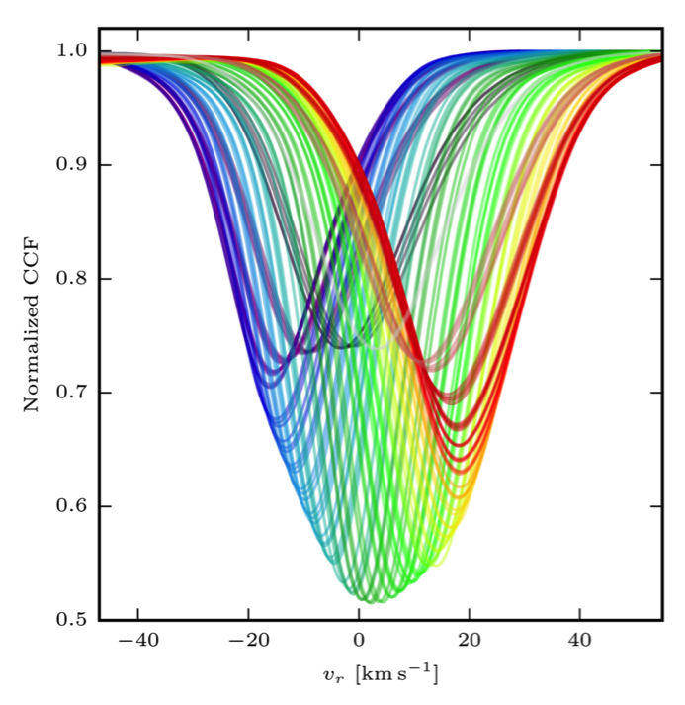
Context II Radial velocities and periodicities
Radial velocity(RV): velocity of a star to an observer projected on the line-of-sight.
Causes: orbital motion(~10-20 [km/s]) + pulsation of the star.
How do we find it: CCF (spectroscopic RV)
Credits: X. Dumusque
Credits: R.I. Anderson+2016
Notes:
Causes: only if corrected from proper motion.

Slide 4
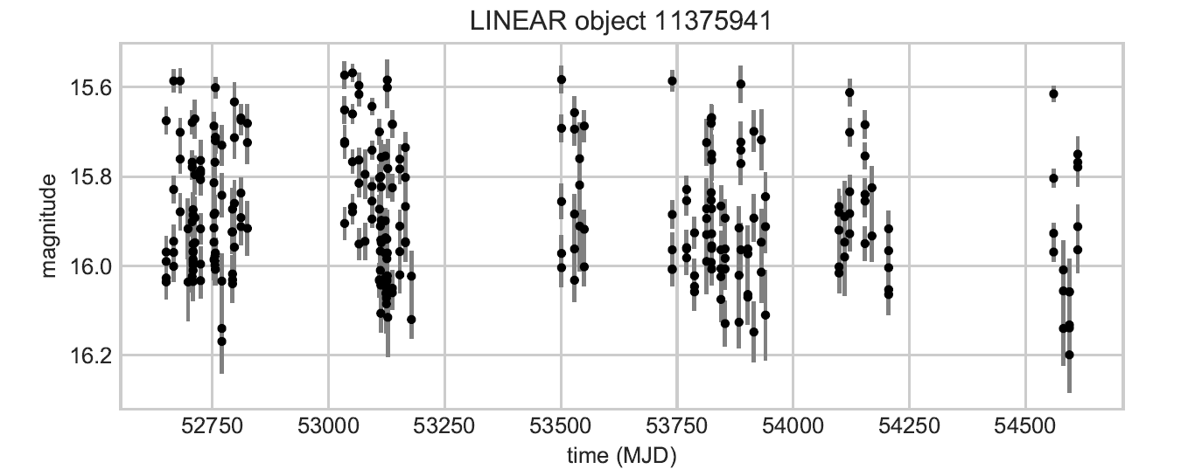
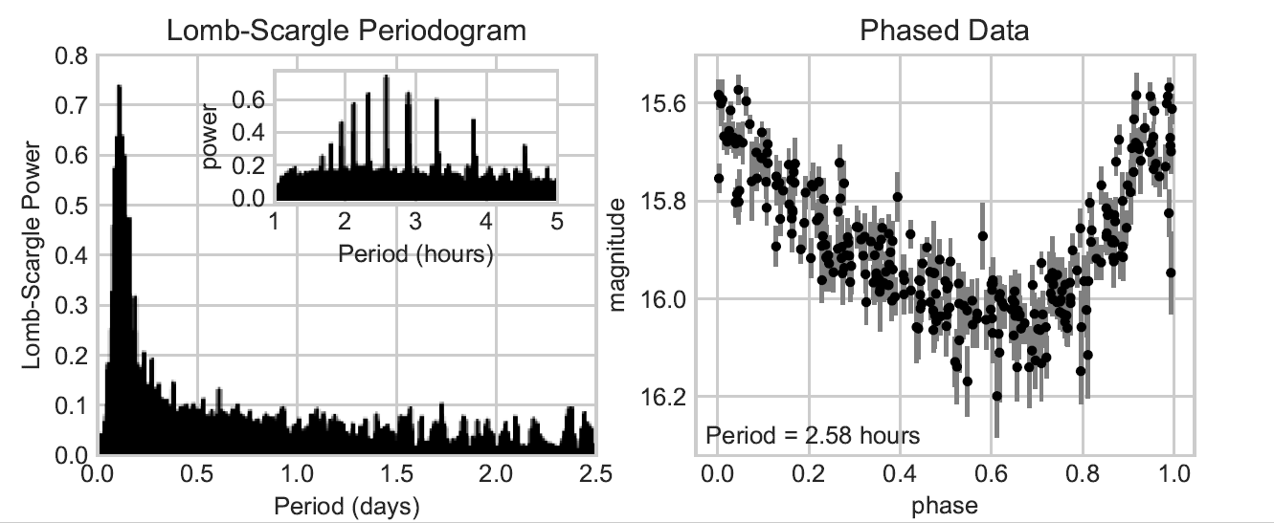
Finding periodicities with RVs.
Phase-folding methods: frequency that optimises a cost function
Least-squares methods: frequency that maximises the likelihood of the fit.
Bayesian approaches.
Fourier methods: Schuster, Lomb-Scargle(LS) etc…
Phase folding
LS
Credits: J. VanderPlas (2018)
Notes:
Here it is with magnitudes but the principle is the same with radial velocities.

Slide 5
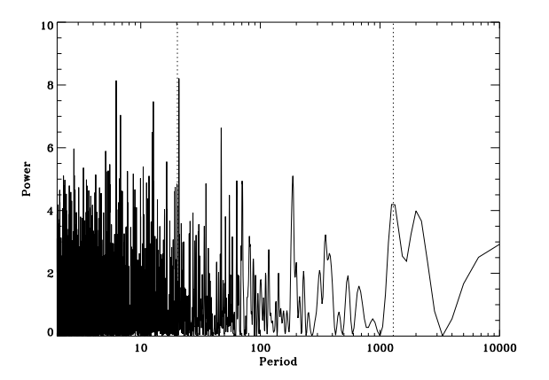
Motivation I Why is the LS periodogram not always enough ?
The case of Classical Cepheid variable stars.
Radial velocity: up to ~60 [km/s].
Often in binary systems.
Effects of pulsation: shift + shape variation of spectrum.
What is the problem then ?
Time-varying shape modulations can
Induce errors in shift measurement
Mimic exoplanet reflex motion
Credits: Carolo et al. (2014)
Notes:
But if you remember before, orbital motion has a RV of around tens of km/s so same order of magnitude.
Induce errors: miss an exoplanet. False-negative.
Mimic: detect by error. False-positive

Slide 6
Motivation II Why this new approach and what does it do?
Important to distinguish orbital from pulsational(stellar activity) motions.
Find companions to Cepheid binaries.
Uncover presence of non-radial pulsations.
Confirm older methods’ results.
Find something else?
Distance correlation-based periodograms:
No sinusoidal assumption
Shift: shape variations influence is controlled
Sensitive to line displacements.
Shape: shift variations influence is controlled
Sensitive to shape variations.
Two periodograms for the price of one

Slide 7
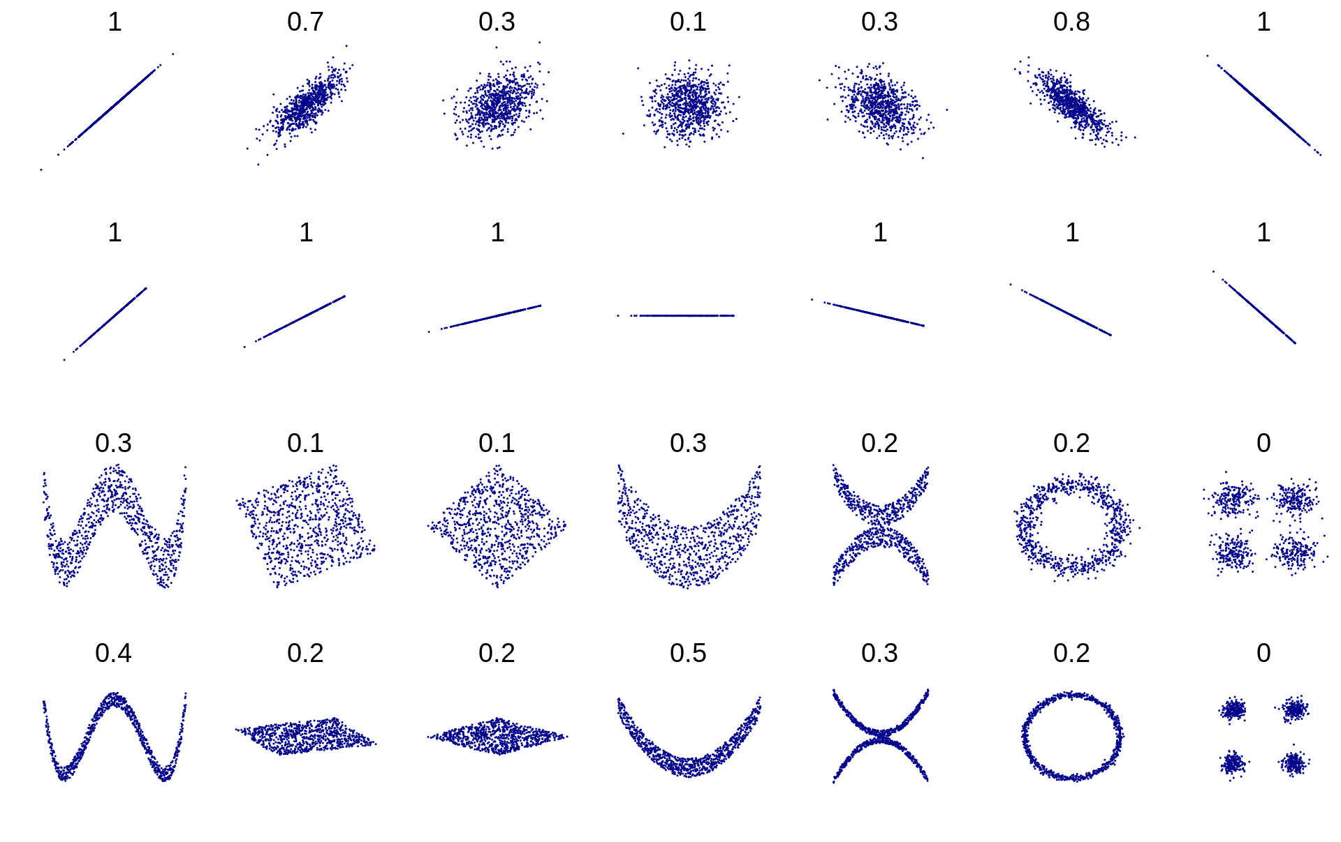
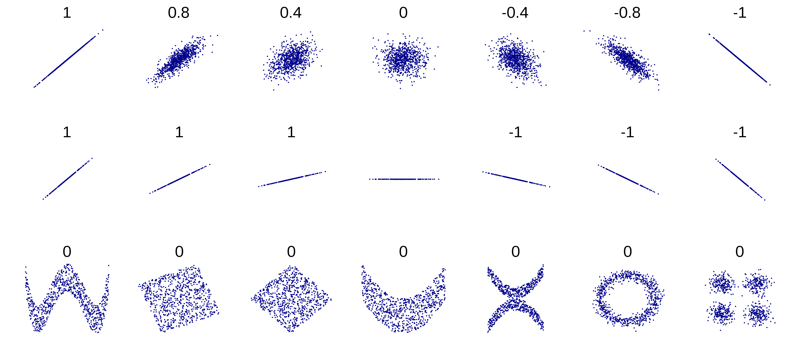
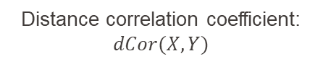
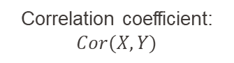
Mathematical framework I Semi-partial distance correlation: A didactic example
Pearson’s correlation: measure of linear statistical relationship between two random variables linear dependence
Distance correlation(Szèkely, 2005): measure of both linear and non linear relationships between two random variables.
General dependence
Correlation coefficient: $Cor(X,Y)$
Distance correlation coefficient: $dCor(X,Y)$
Notes:
Two things to notice: first goes from 0 to 1 and second most importantly it’s not zero if the variables are non-linearly correlated.

Slide 8
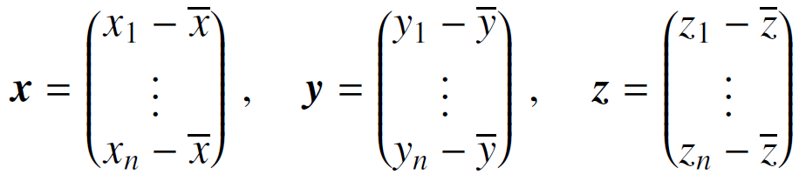
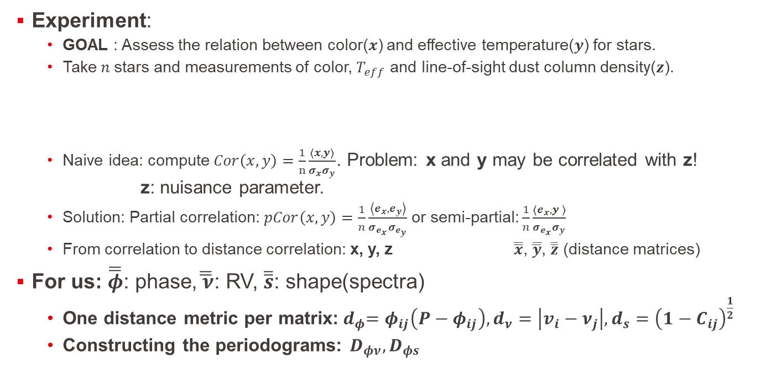
Mathematical framework II Semi-partial distance correlation: A didactic example
Experiment:
GOAL : Assess the relation between color($x$) and effective temperature($y$) for stars.
Take $n$stars and measurements of color, $T_{eff}$ and line-of-sight dust column density($z$).
Naive idea: compute $Cor\left(x,y\right)=\frac{1}{n}\frac{\left\langle x,y\right\rangle }{σ_{x}σ_{y}}$. Problem: x and y may be correlated with z! z: nuisance parameter.
Solution: Partial correlation: $pCor\left(x,y\right)=\frac{1}{n}\frac{\left\langle e_{x},e_{y}\right\rangle }{σ_{e_{x}}σ_{e_{y}}}$ or semi-partial: $\frac{1}{n}\frac{\left\langle e_{x},y \right\rangle }{σ_{e_{x}}σ_{y}}$
From correlation to distance correlation: x, y, z $\overline{\overline{x}}$, $\overline{\overline{y}}$, $\overline{\overline{z}}$ (distance matrices)
For us: $\overline{\overline{φ}}$: phase,$\overline{\overline{ ν}}$: RV, $\overline{\overline{s}}$: shape(spectra)
One distance metric per matrix:${ d}_{φ}=φ_{ij}\left(P−φ_{ij}\right), d_{ν}=\left|v_{i}−ν_{j}\right|, d_{s}={\left(1−C_{ij}\right)}^{\frac{1}{2}}$
Constructing the periodograms: $D_{φν}, D_{φs}$
Notes:
Z is called a nuisance parameter and affects the relation between x and y.
Phi_ij = (t_i-t_j)mod(P)
For us, it’s a little bit different. We want to find periodicities(orbital or stellar activity) so we want to compute the correlation between phase and rvs and phase and shape variations. In shape variations, rvs are a nuisance parameter and in rvs variations, shape is the nuisance parameter.

Slide 9
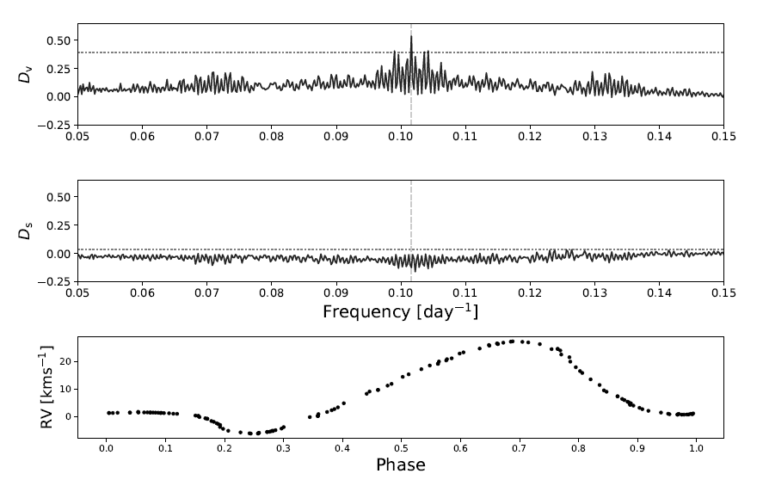
Some examples: β Doradus
Classical Cepheid(no known companion)
135 CORALIE observations
Range tested: 4900-5150 Å
Periods recovered:
Radial pulsation periodicity: ~9.84 days
Credits: Binnenfeld et al.(2021)
(badly labeled)

Slide 10
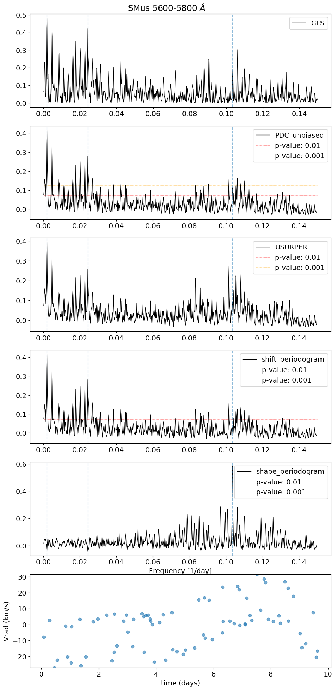
Some examples: S Muscae
Binary classical Cepheid
60 CORALIE observations: 01.2012 05.2018
Range tested: 5600-5800 Å
Periods recovered:
Radial pulsation periodicity: ~9.66 days
Orbital periodicity: ~505 days
Window function: 40 days

Slide 11
What have I been doing apart from calcetto and cycling?
Finding the right peak
Harmonics, aliases, window function.
What wavelength ranges should be avoided?
Impact of tellurics (« high-frequencies » of Earth’s atmosphere)
What range size should be used?
Low frequency variations of Earth’s atmosphere.
Preprocessing
What range gives the best results?
Asserting the statistical significance of a peak.
Can a FAP be computed without implementing bootstrap?
Notes:
Basically asking a lot of questions.

Slide 12
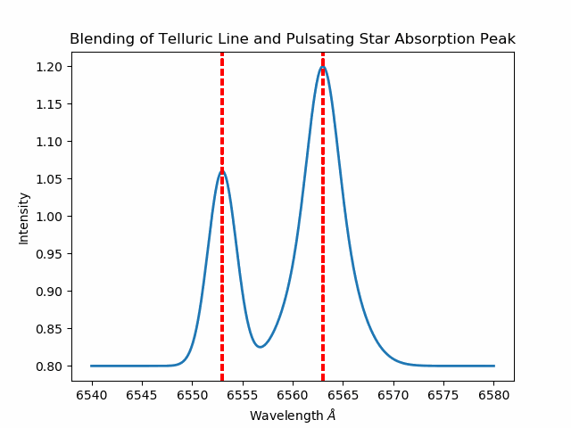
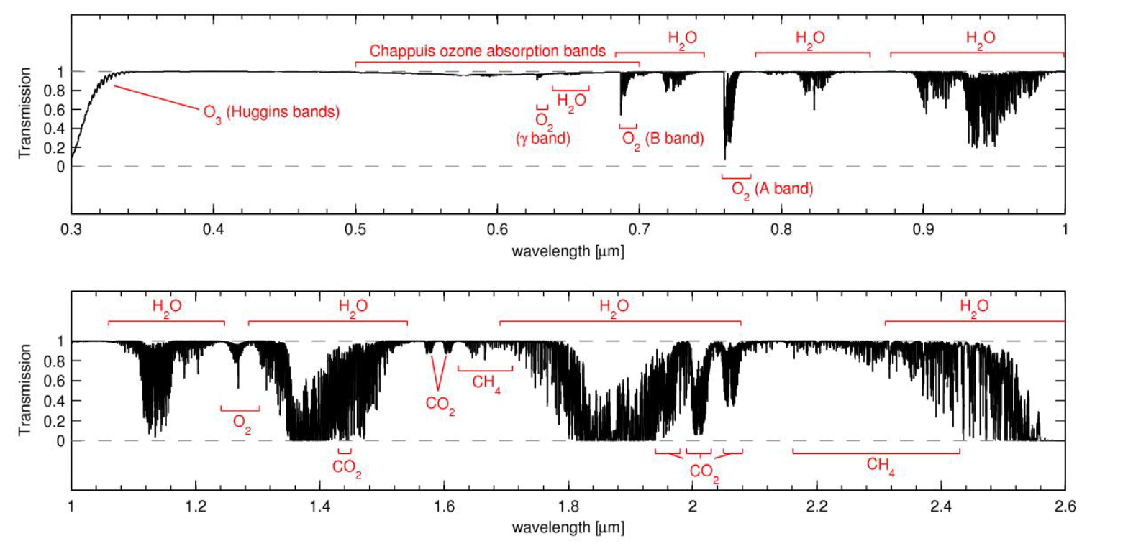
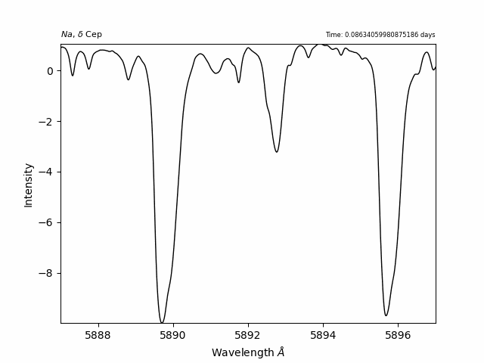
Tellurics The sky is a limit
Why do certain ranges give the «wrong» result in the shape periodogram?
Credits: Przybilla

Slide 13
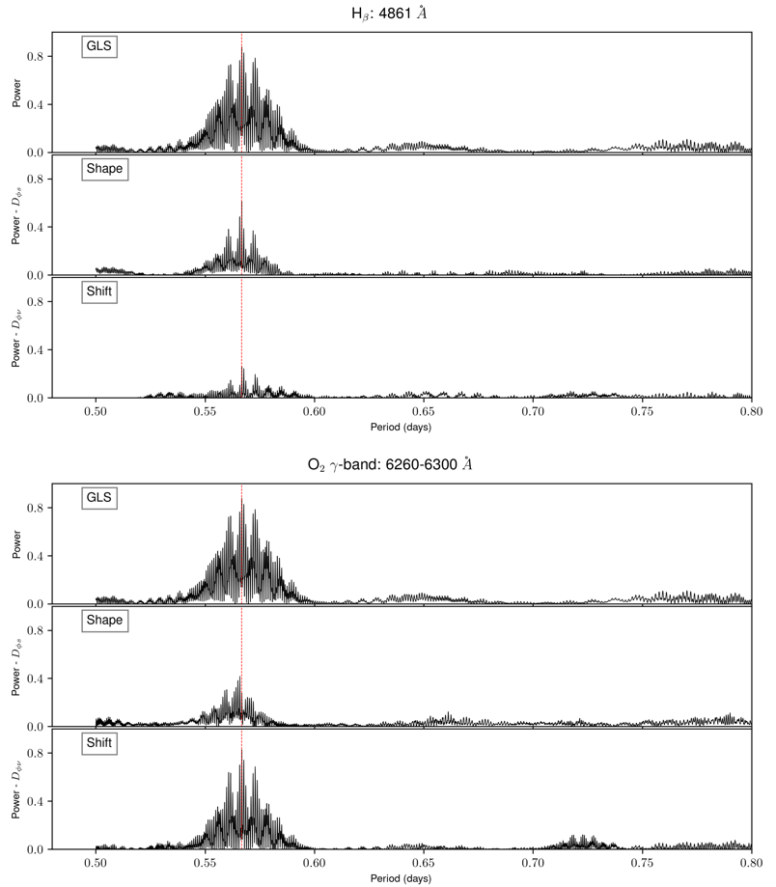
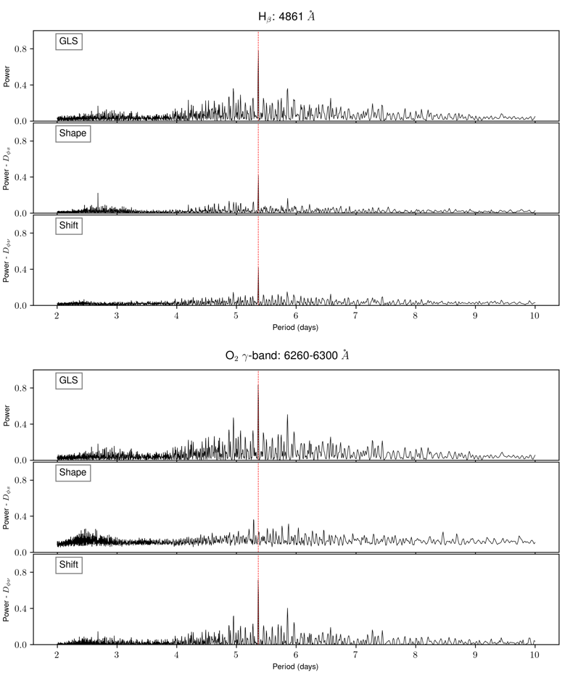

$δ$ Cephei
RR Lyrae
Notes:
Basically: Since I don’t have a model spectrum of the sky in La Palma and La Scilla, I decided to just simply avoid any range above 5600A.
Talk about Thursday meeting: When a Cepheid is pulsating, it causes both a shape and shift in the spectrum. The fact that the shift and shape periodogram show both a peak at the main periodicity could be because the main shape signal of the star is not properly removed from the shift periodogram(the metric used to compute the shape is the correlation between a pair of spectra i,j shifted the assumed rest frame according to v_i, the radial velocity of spectra i). And this signal is maybe not properly removed because when the RVs are precise but not necessarily accurate so some residual shift signal is still left and this is unfortunately captured by the shift periodogram. The good thing is that it could be a way to assert whether the method used to compute the radial velocities is accurate or not.

Slide 14
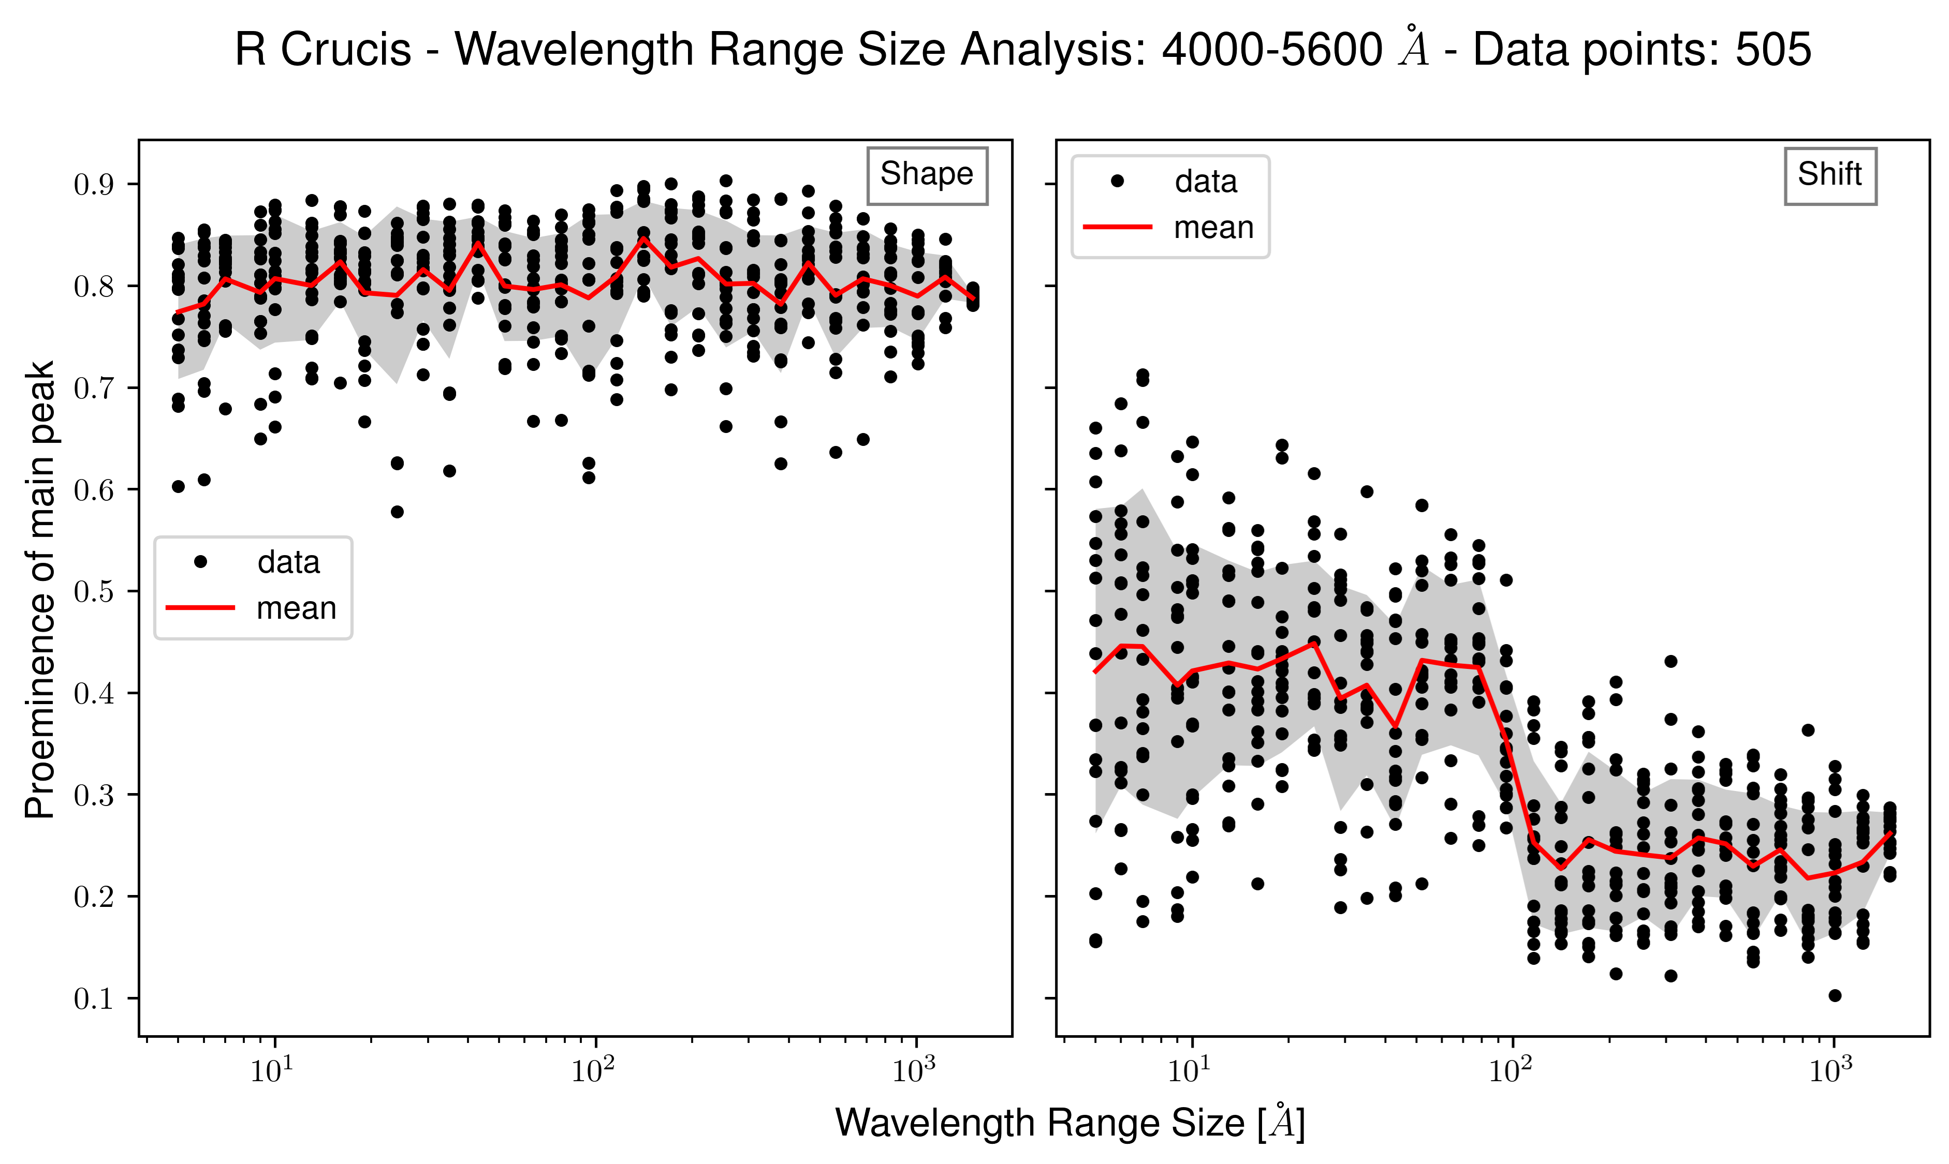
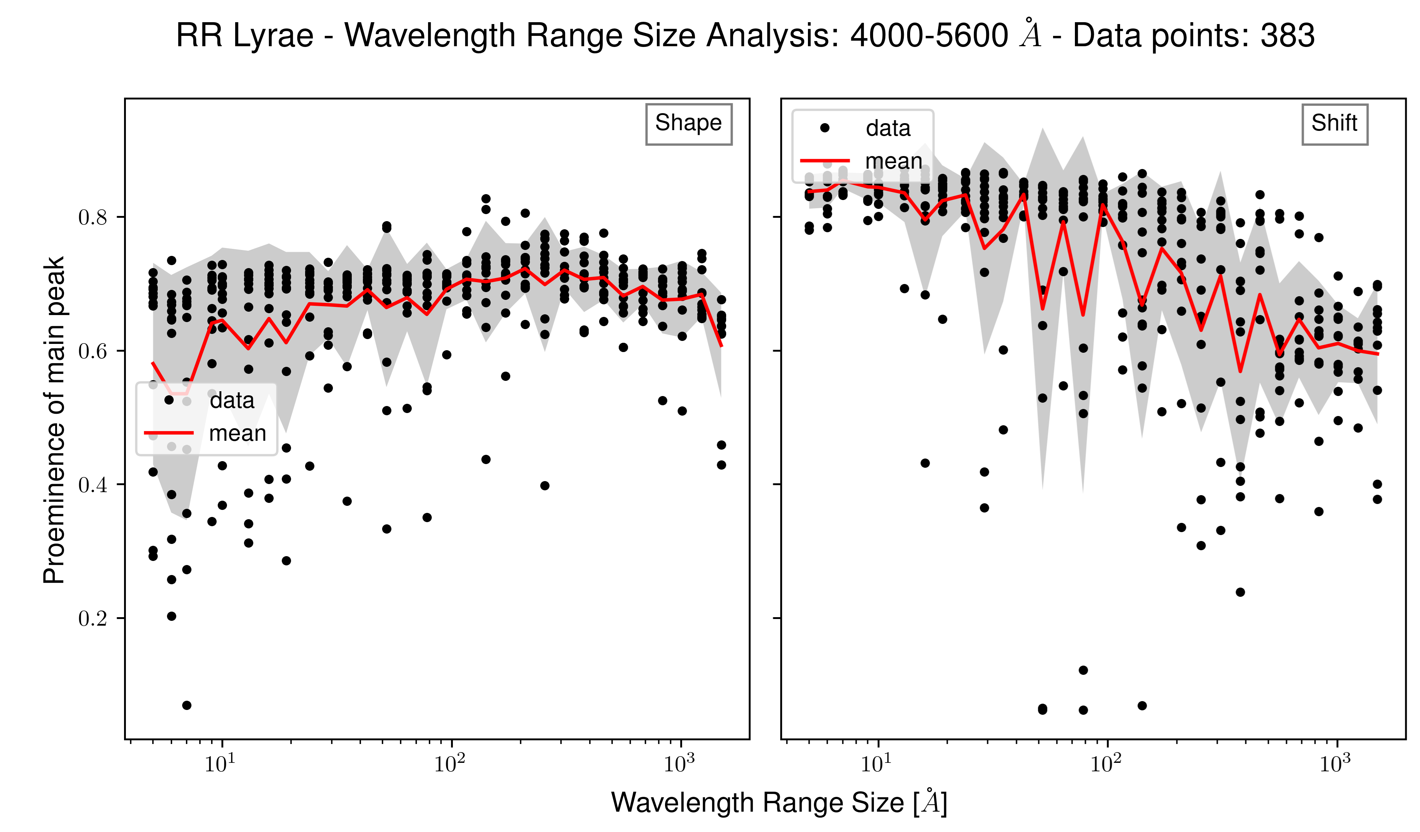
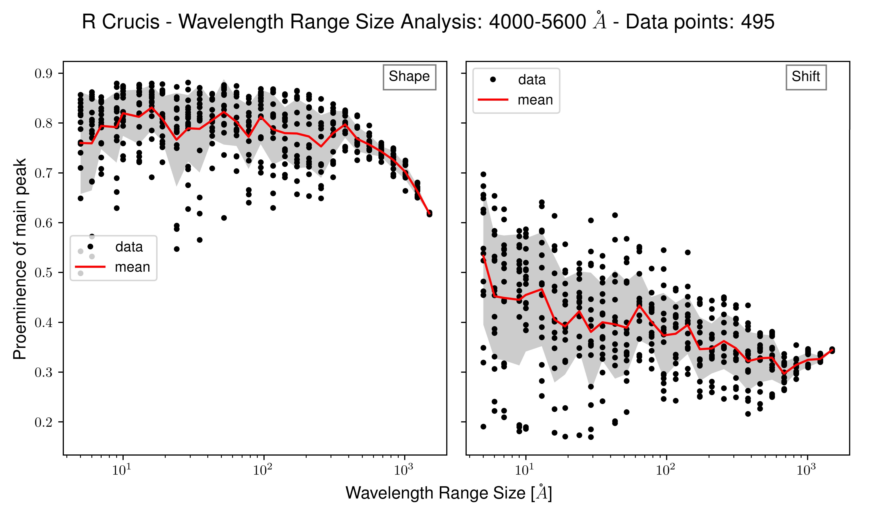
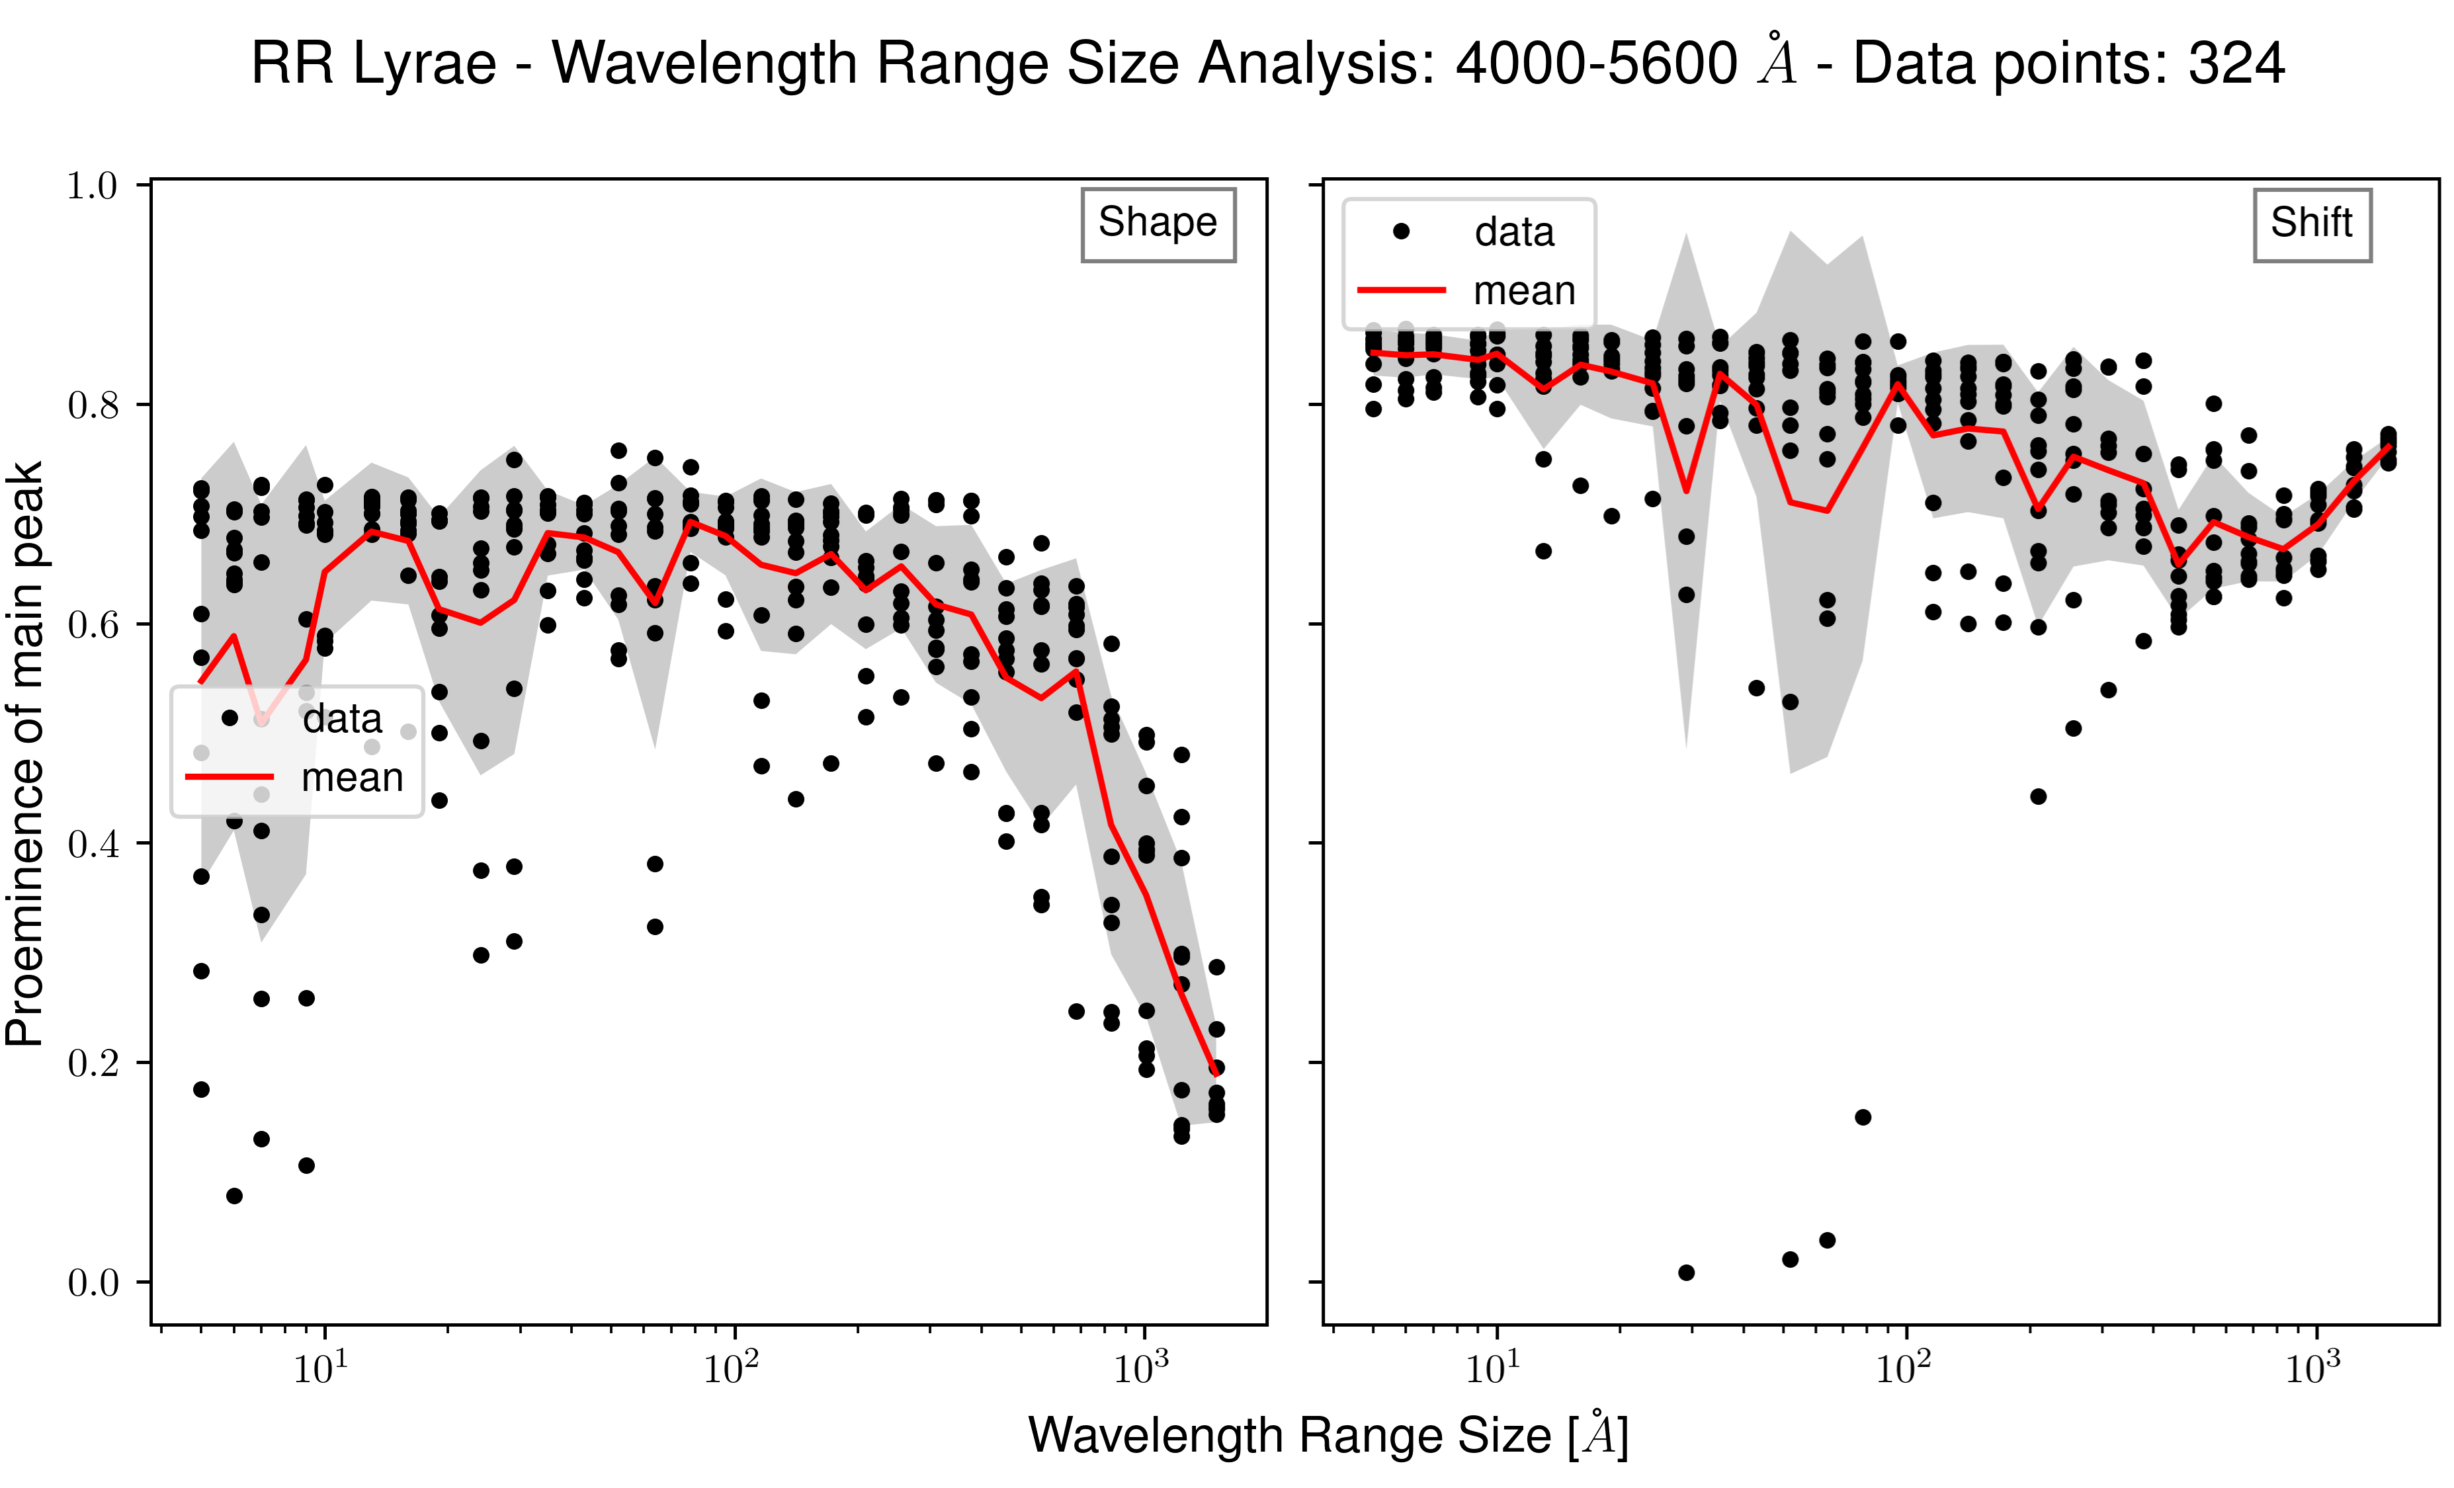
Finding the right wavelength range: The effect of preprocessing
Notes:
To improve: Change proeminence to a quantity that better represents the significance of a peak(ratio of power to mean of the whole signal?)
Filtering does have an impact. Without it, the shape periodogram is maybe picking up the low frequency signal of Earth’s atmosphere envelope. Moreover, CCF = mean-spectral line of all the lines selected by the template so use a bigger wv range to have the shape periodogram represented by spectrums more representative of their respective radial velocities computed with Veloce.
To improve: do it for all the other stars.

Slide 15
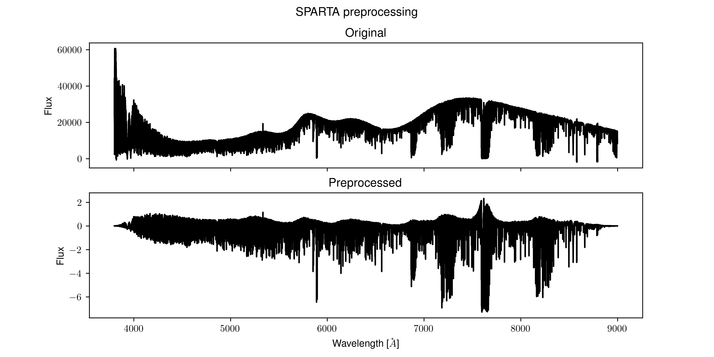
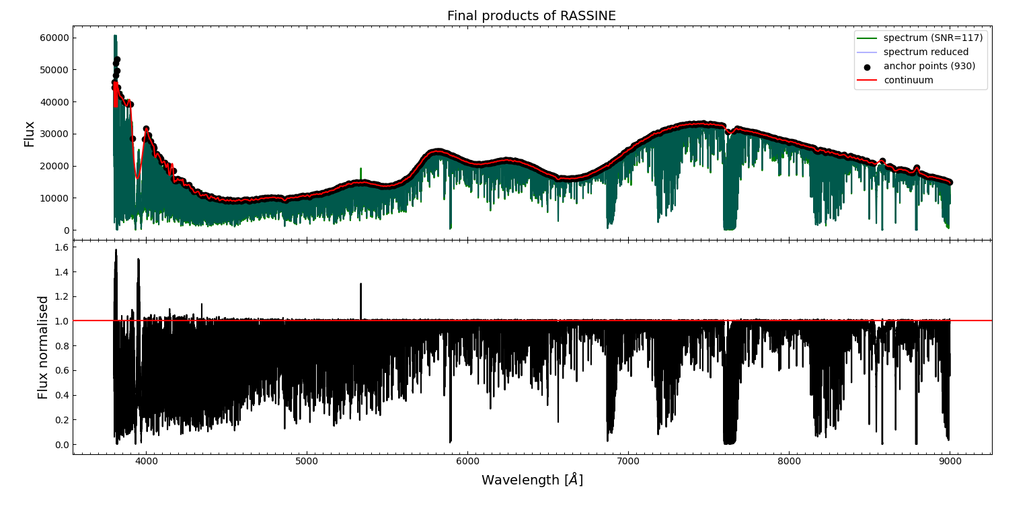
Finding the right wavelength range: The effect of preprocessing
Hopes
Get cleaner periodograms(avoiding Earth’s atmosphere low-frequencies)
Enable bigger wavelength ranges(less shift signal too maybe at shape frequency?)
R Cru and ASAS orbital signals?

Slide 16
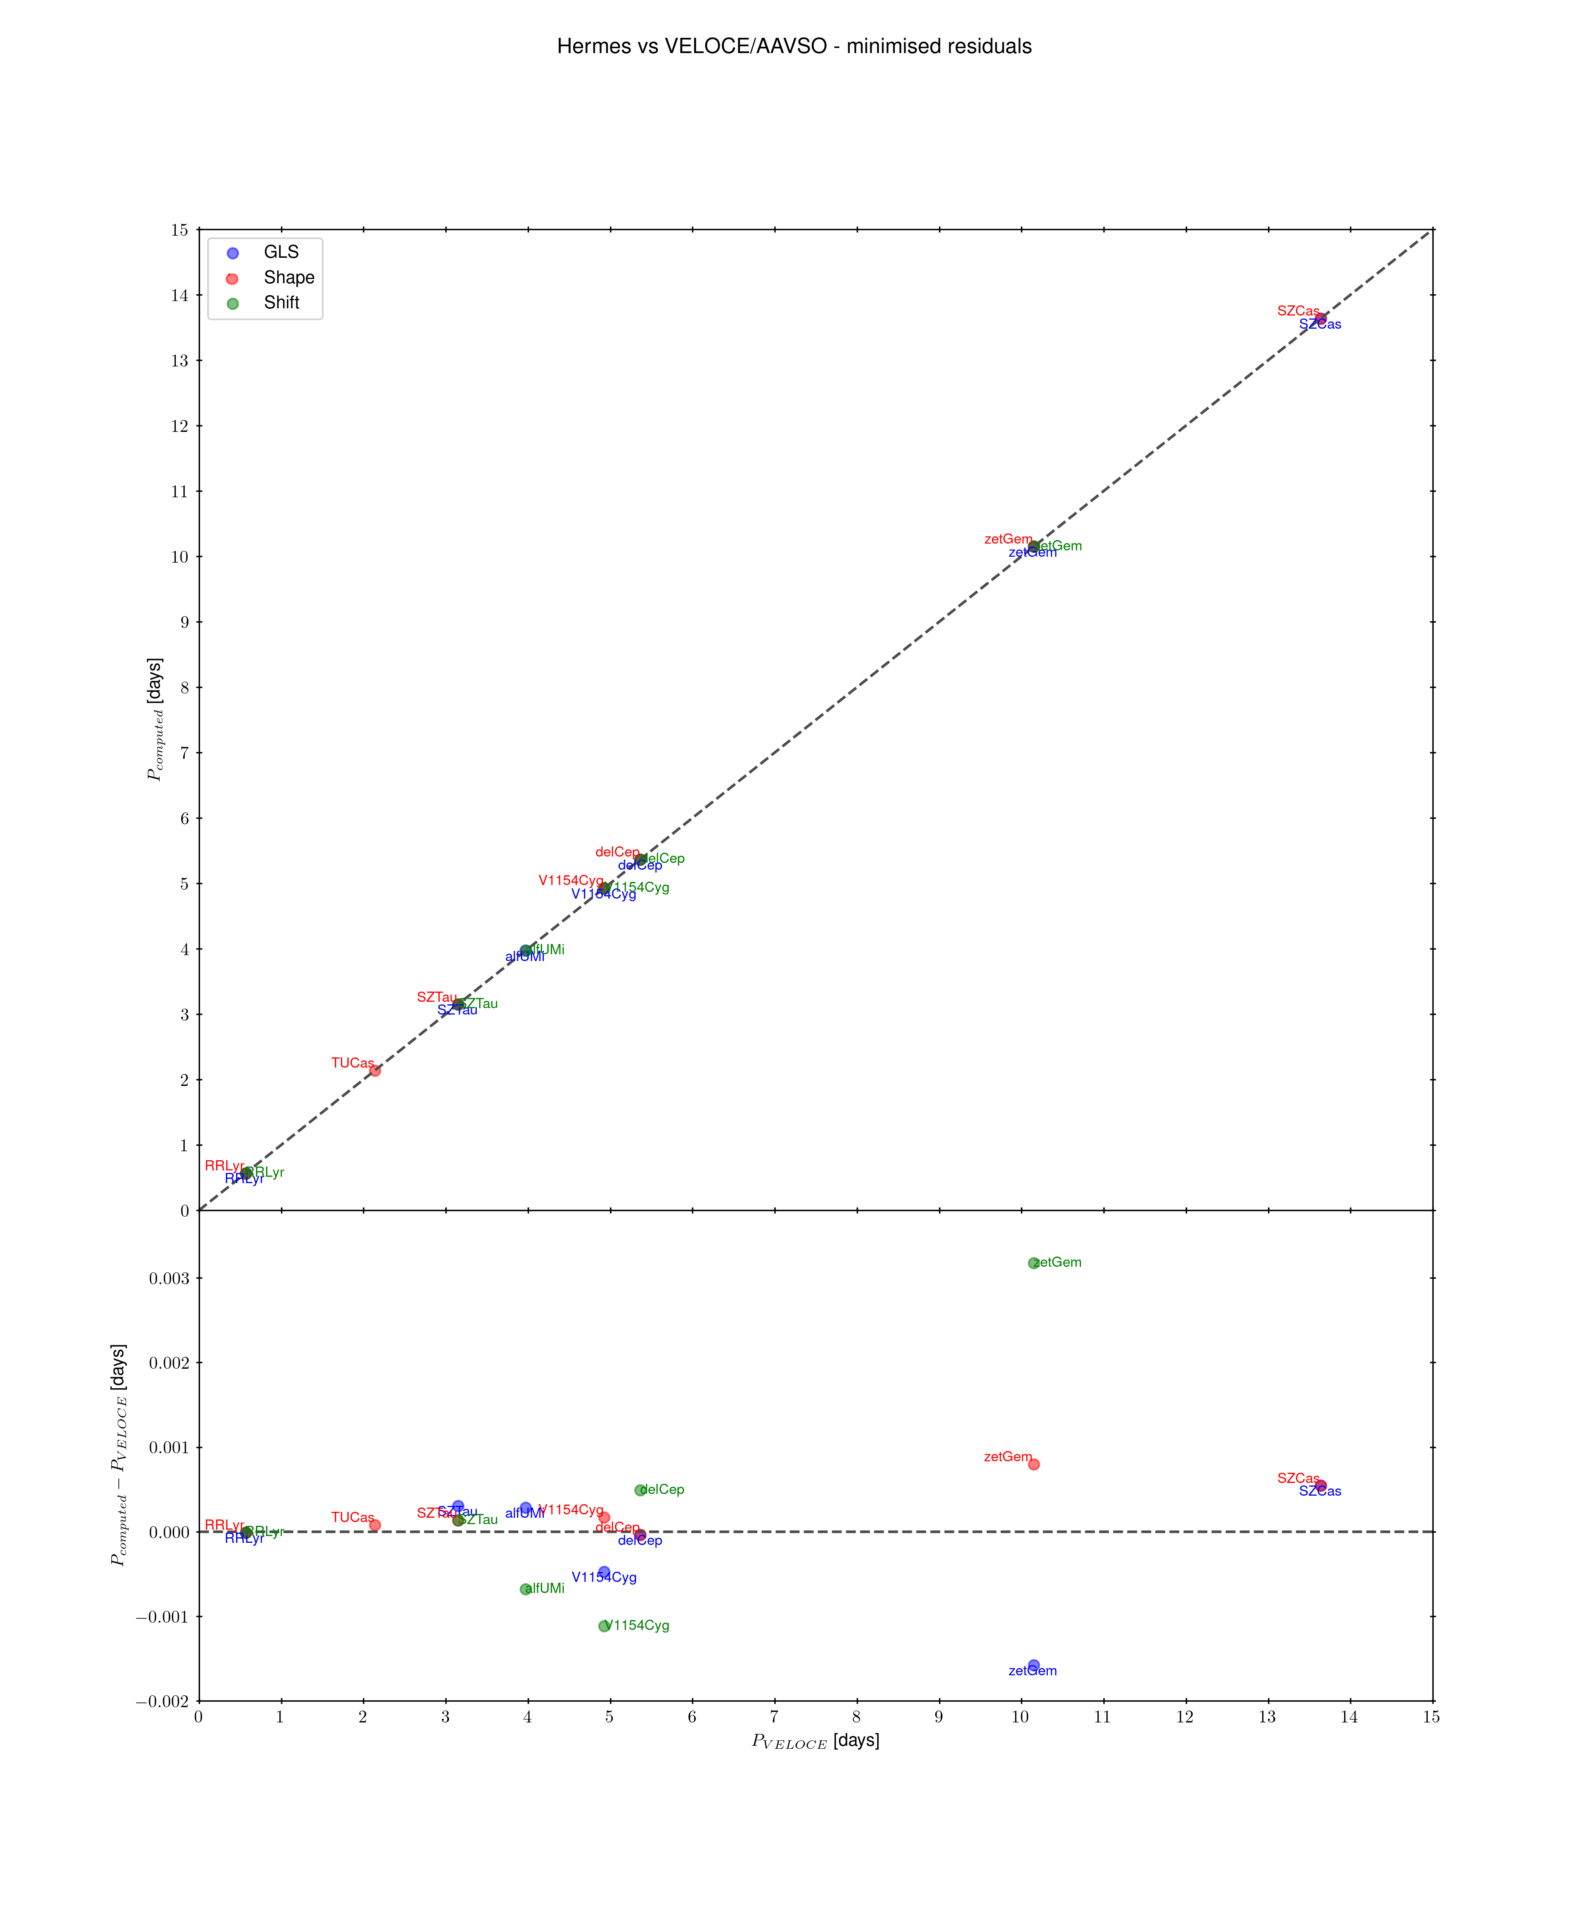
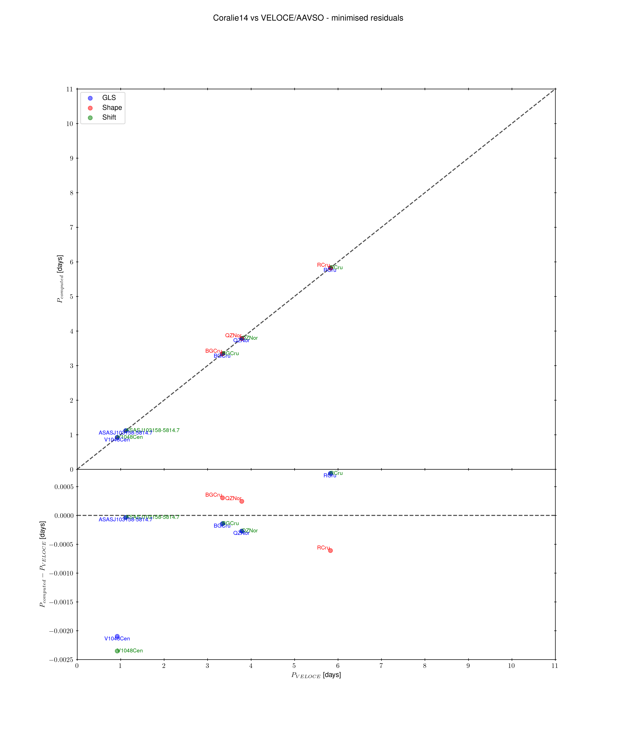
Results on a dataset of 15 stars: Hermes + Coralie14
Notes:
So these are the results for all 15 stars. Given the discussion above, the important points to look at here is the shape periodogram for the main periodicity. As for orbital signals in the shift, only two stars were expected to have one: R Cru and ASAS. No signal for RCru, but a broad peak at 310 days for ASAS. Apart from that: All Hermes except Polaris stars have their main period found with the shape periodogram at max power(7/8)
For Coralie14, only R Cru, BG Cru and QZ Nor have their main period found with the shape periodogram at max power(3/7)

Slide 17
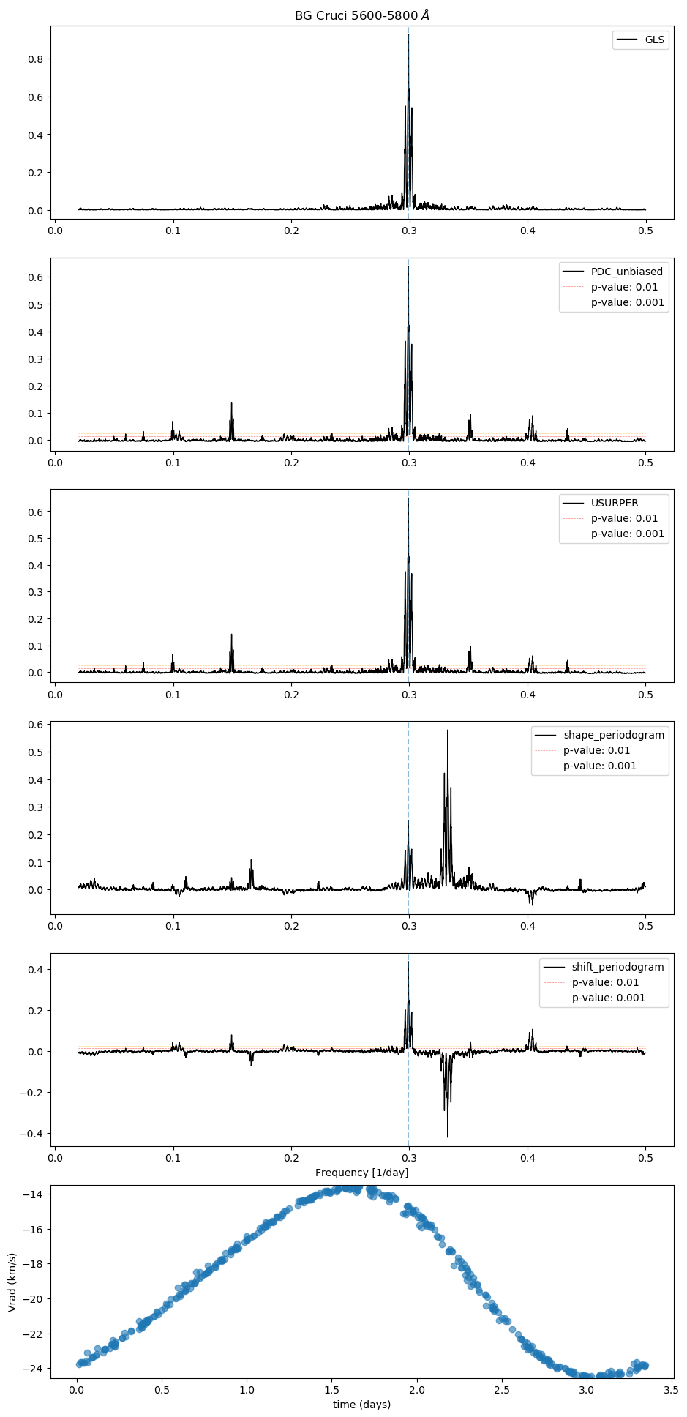
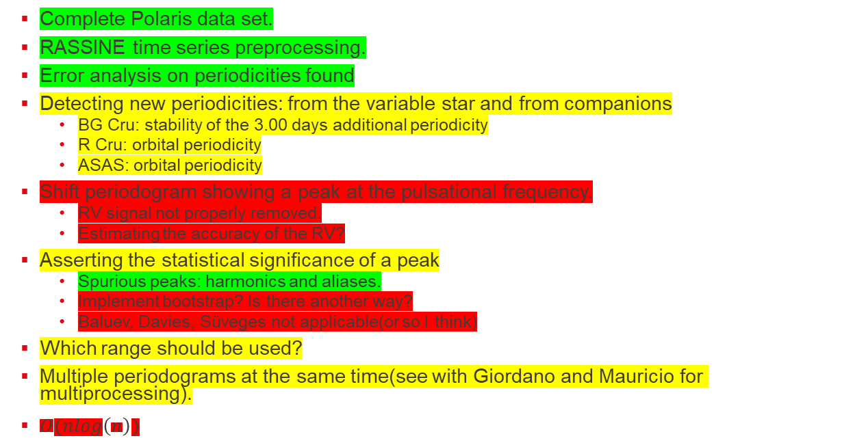
For the future
Complete Polaris data set.
RASSINE time series preprocessing.
Error analysis on periodicities found
Detecting new periodicities: from the variable star and from companions
BG Cru: stability of the 3.00 days additional periodicity
R Cru: orbital periodicity
ASAS: orbital periodicity
Shift periodogram showing a peak at the pulsational frequency.
RV signal not properly removed.
Estimating the accuracy of the RV?
Asserting the statistical significance of a peak
Spurious peaks: harmonics and aliases.
Implement bootstrap? Is there another way?
Baluev, Davies, Süveges not applicable(or so I think)
Which range should be used?
Multiple periodograms at the same time(see with Giordano and Mauricio for multiprocessing).
$O(nlog\left(n\right))$

Slide 18
Conclusion
Goal of the algorithm: Separately identify Doppler and spectral-shape modulations.
Results:
Avoid tellurics
Use wavelength ranges of ~100-200 angströms is enough with original preprocessing.
All Hermes except Polaris stars have their main period found with the shape periodogram at max power
For Coralie14, only R Cru, BG Cru and QZ Nor have their main period found with the shape periodogram at max power.
Shift periodogram shouldn’t show a peak at the shape periodogram’s stellar pulsation peaks -> could be a way to know if the RVs a accurately measured.
Questions on my mind:
Does this shift problem pose a problem to finding orbital companions?
Does it make the shape periodogram less efficient?
Why does BG Cru’s second periodicity show a hole in the shift periodogram and its main periodicity don’t even though it has a higher power?
Why is ASAS’ shape periodogram flat?
Polaris/BG Cru/zetGem: upward, downward trend.

Slide 19
References
A. Binnenfeld, S. Shahaf, R. I. Anderson and S. Zucker. New Periodograms Separating Orbital Radial Velocities and Spectral Shape Variations. A&A 659 A189 (2022)
J. T. VanderPlas. Understanding the Lomb-Scargle Periodogram. ApJS 236 16 (2018)
R. I. Anderson, G. Viviani et al. VELOCE I. High-Precision Radial Velocities of Cepheids. [Manuscript submitted for publication], IPHYS EPFL Switzerland.
M. Cretignier, J. Francfort, X. Dumusque, R. Allart and F. Pepe. RASSINE: Interactive Tool for Normalising Stellar Spectra. A&A 640 A42 (2020)

Slide 20
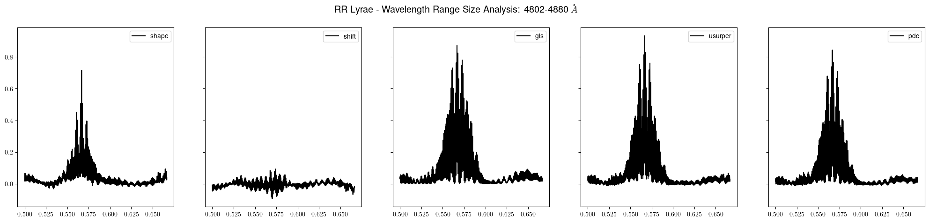
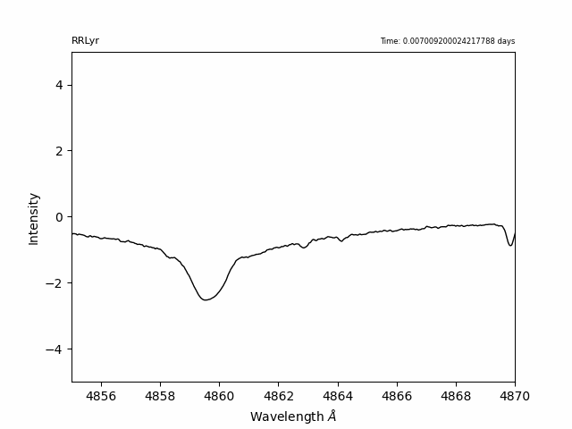

RR Lyrae shockwaves on $H_{β}$

